Slide 1



PROJECT – 5 IMDB MOVIE ANALYSIS.
WWW.WEBSITE.COM
WWW.WEBSITE.COM
Planets
Although behind red, Mars is actually a very cold place.
Mercury is the second planet from the Sun
SWIPE UP!
By Deeksha

Slide 2
Table of contents
➢ Project Description
➢ Approach
➢ Tech-Stack Used
➢ Insights
➢ Result
IMDB Movie Analysis working excel sheet : click here

Slide 3

Project Description
The company's dataset includes a number of columns with various IMDB Movies. We must first define the problem. We must first identify the issue we wish to illuminate for this endeavor.
In order to achieve this, we can ask the question. "What?” What do we observe taking place?
• What is our theory regarding the origin of the issue? (This will largely be based on gut feeling initially)
• What effects does the issue have on stakeholders?
• What would occur if the problem wasn't fixed?

Slide 4
How to deal with the situation:
Clean the data.
Investigate the data set using your data analysis skills.
Gain knowledge.
The project will reveal information about the common genres, distribution of movie durations, most common languages , top directors, correlation between movie budgets and gross earnings.

Slide 5

Approach
In order to complete this project, we must first comprehend the provided data. Then, we will clean the data to meet our needs by eliminating null values, extraneous columns, etc. Following the cleaning, we will use pivot tables, several functions, and charts to obtain the desired answers to the queries. We'll keep asking why questions of the data to go further into the issue's cause.
Tech-Stack Used
Microsoft Excel

Slide 6
Insights
Data Cleaning
1. Removing any extra columns.
(Colour, director Facebook likes, actor 3 Facebook likes, actor 2 Facebook likes, actor 1 Facebook likes, cast Facebook total likes, actor 3 Facebook likes, posts, plot ,movie Imdb link, content_rating, actor 2 Facebook likes, aspect ratio, and movie Facebook likes).
2. Remove Null Values or Blank Cells.
3. Eliminating Duplicates.

Slide 7
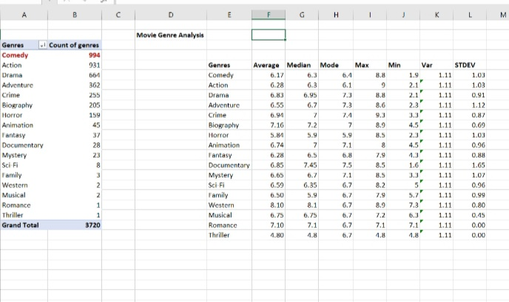
A. Movie Genre Analysis
Find the most common genres of movies and calculate descriptive statistics

Slide 8
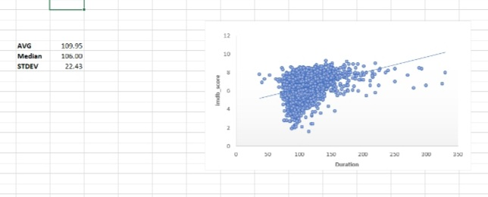
B. Movie Duration Analysis
Analyse how long films are on average.
There is a positive correlation between the length of the film and its imdb score, as can be seen by the increasing trendline in this instance.

Slide 9
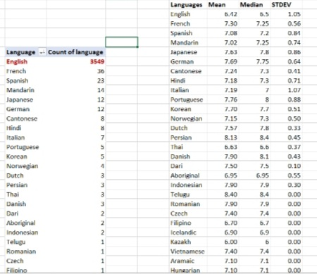
C. Language Analysis
Identify the most widespread languages.

Slide 10
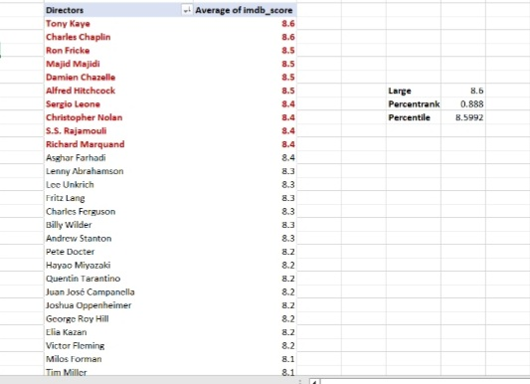
D. Director Analysis
Identify the top directors

Slide 11
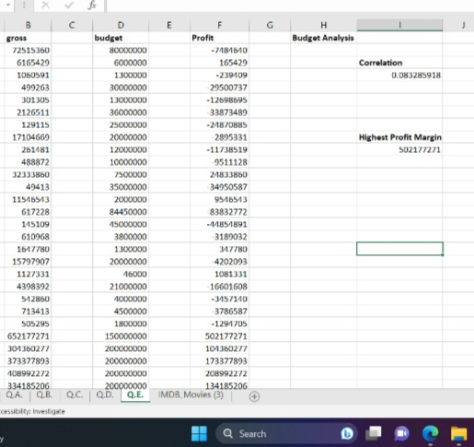
E. Budget Analysis
Examine the relationship between movie budgets and box office receipts.

Slide 12
I used both fundamental and sophisticated Excel principles in my assignment. MS Excel has been used in this instance to implement the ideas connected to statistics and EDA. • The principles of sorting, filtering, pivot tables, charting, and many functions, including rank, have all been used in this work. • I gained experience using my Excel knowledge to real-world projects. • By looking at the dataset and asking "what," I discovered how to frame a problem. • I learned how to do a "5 Why Analysis" to identify the problem's underlying causes. • I discovered how a data analyst develops increasingly insightful thought processes. • While working on this assignment, I learned a lot, and it was also tough because I had to ask a lot of questions and finding the solutions
Result

Slide 13
THANK YOU

